Slide 1
Diploma in Funeral Arranging & Administration
Unit 3.8
Human Cremation
Law & Practice

Slide 2
Today’s objectives
Understand the operational working of a crematorium.
Understand the purpose of the cremation documentation.
Know which surgical implants require removal.
Understand the purpose of the Federation of Burial and Cremation Authorities’ (FBCA) Code of Practice and general guidelines.
Know the administrative process for the cremation of body parts.
Know the methods and documentation for the disposal of cremated remains.
Understand the scattering/interment of cremated remains.
Know the available options for memorialisation.
Know the current guidelines for the disposal of unclaimed cremated remains.

Slide 3
Cremation Regulations 2008: 1
Sets out provision for the opening and closing of crematoria
Closure requires one month’s notice and local publicity
Also provides for inspection thereof
Also for their record keeping (eg submitted forms for cremation should be retained for 15yrs or 2yrs if an electronic copy is made)
Provides for the appointment and removal of medical referees (and deputies as required)
Must be registered medical practitioners of 5yrs standing
And for them to report to the Secretary of State
Provides for the appointment of a registrar and his/her duties
And for their registers of cremation and what they contain

Slide 4
Cremation Regulations 2008: 2
Sets out new Forms 1-13 and the additional documentation required for cremation
And that the content and format of these should be adhered to and may be refused if they are not
Provides the right for the applicant to inspect the medical certificates
Provides for the medical referee to order a PM if not satisfied as to the cause of death and the terms by which an inquest might follow (if the PM still does not satisfy the referee as to the cause of death)
Refusal to authorise cremation should be given to the applicant in writing

Slide 5
Cremation Regulations 2008: 3
Permits incineration of body parts other than by cremation where appropriate regulation and permits apply
Sets out how the crematorium should treat ashes
Eg the 14 day grace period for scattering ashes left at the crematorium is found here

Slide 6
Cremation Code of Practice
Provides for:
Good conduct and training
No bodies to be removed from the crematorium without proper permission
That the whole coffin is cremated
Separate cremation
Care in identification throughout the proceedings
Proper disposal of metals
Separate identification of ashes
Maintenance of equipment
Observation of the law

Slide 7
FBCA Guidelines
FD acting responsibly and following the Cremation Authority’s regulations
Submitting correct and timely paperwork
Supplying a suitable coffin, including its fittings and lining
Not permitting hazardous or pollutant items in the coffin
Giving proper advice to applicants, especially with regard to infant and NVF funerals and cremation of body parts
Providing a suitable container for cremated remains

Slide 8
The statutory forms
Application for cremation
Application for cremation – body parts
Application for cremation – stillbirth
Medical certificate
Confirmatory medical certificate
Certificate of Coroner
Certificate following anatomical examination
Certificate releasing body parts for cremation
Certificate of stillbirth
Medical referee’s authority to cremate (full)
Certificate after post-mortem examination
Medical referee’s authority to cremate (body parts)
Medical referee’s authority to cremate (stillbirth)

Slide 9
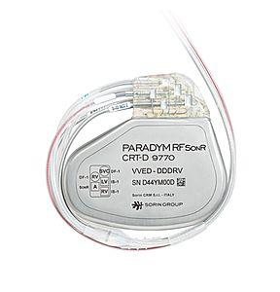
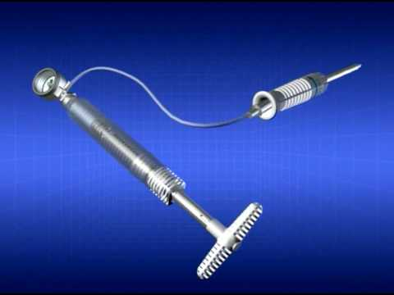
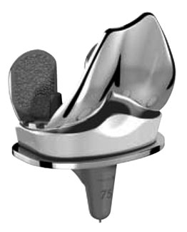
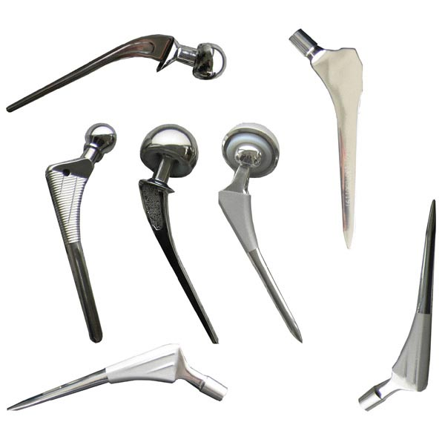
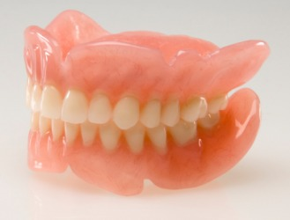
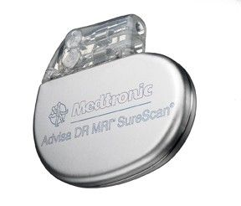
Defibrillator
Fixion nail
Knee joint
False teeth
Hip joints
Pacemaker

Slide 10
Defibrillator
Remove

Slide 11
Fixion nail
Remove

Slide 12
Knee joint
Remain

Slide 13
False teeth
Remain

Slide 14
Hip joint
Remain

Slide 15
Pacemaker
Remove

Slide 16
Cremation procedure
Coffin goes through to holding area
Name plate check
Label applied if not immediately into cremator
Coffin placed into cremator – ticket on door
Cremation takes place
Residue raked into pan
Cooling
Residue into cremulator - with ticket
Ashes into container (metals removed)
Crematorium issues Certificate of Cremation (if ashes being removed)

Slide 17
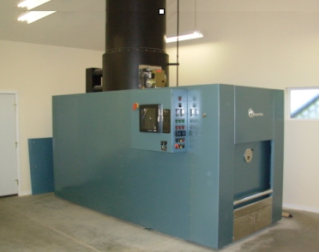
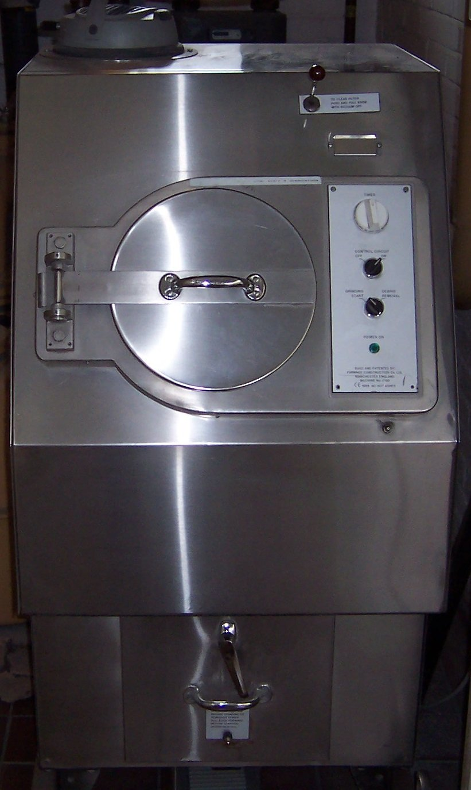
Cremator
Cremulator

Slide 18
Basic questions
Which crematorium?
Which chapel, if there is more than one?
Coroner or not?
Who is to be the applicant?
Method of ashes disposal
What music may be required (to book organist and Wesley system if applicable)?
Is there a wish to inspect certificates?

Slide 19
Adult cremation with Coroner
Form 1: Application for cremation
Form 6: Certificate of Coroner
Notice of particulars / preliminary application for cremation
Authority for disposal of ashes
Form 10: Authority to cremate is completed at the crematorium

Slide 20
Adult cremation with doctors’ papers
Form 1: Application for cremation
Form 4: Medical Certificate
Form 5: Confirmatory medical certificate
Registrar’s certificate for burial or cremation
Notice of particulars / preliminary application for cremation
Authority for disposal of ashes
Form 10: Authority to cremate is completed at the crematorium

Slide 21
Children’s Cremations: Foetal Remains
No status in law. ICCM guidance is:
Certificate of Medical Practitioner / Midwife
Cremation Authority’s own application form
Some say:
Release of body parts – Cremation 2
Application to cremate body parts – Cremation 8
Authority to cremate body parts – Cremation 12
+ authority for ashes and Notice of Particulars
Some crematoria have their own forms.

Slide 22
Children’s funerals: Stillbirth
Registrar’s Certificate for Burial or Cremation (Stillbirth)
Cremation 9 – Certificate of Stillbirth from medical practitioner or midwife
Cremation 3 – application for cremation
Cremation 13 – medical referee’s authorisation for cremation
OR/
Cremation 3 – application for cremation
Cremation 6 – Coroner’s certificate for cremation
Cremation 13 – medical referee’s authorisation for cremation

Slide 23
Children’s funerals: infant
Any child born alive:
Normal regulations apply.

Slide 24
Options for ashes disposal
Disperse in the Garden of Remembrance at the crematorium (with or without witness)
Scatter at another crematorium
Bury in a cremation plot
Bury or scatter on an existing grave
Place in a columbarium
Scatter (with permission) on private ground
Scatter at sea or on a river
Us to retain pending a decision
Client to retain

Slide 25
Disposal Procedures: 1
Garden of Remembrance: Crematorium
Ashes disposal authority signed by Applicant
Garden of Remembrance: Cemetery
Certificate of cremation
Cemetery’s application form / Notice of Interment (if applicable)
Churchyard: interment or strewing
(Scattering unlikely to be permitted)
Certificate of cremation

Slide 26
Disposal Procedures: 2
Interment in a full grave
Certificate of cremation
Notice of Interment
Transfer of deed (if necessary)
Digging ticket (if necessary)
Columbarium/Niche at Crematorium
Ashes disposal signed by applicant
Certificate of Cremation (if ashes being returned)
Possibly memorial application/purchase
Disposal at Sea
Certificate of Cremation

Slide 27
Polytainer / Cremtainer

Slide 28
Cardboard crematorium container

Slide 29
Traditional wooden casket

Slide 30
Lawnswood urn

Slide 31
Bamboo casket

Slide 32
Scattering tube

Slide 33
Sanctum 2000

Slide 34
Protocol for ashes disposal
Ashes held in the FD’s care should be recorded in a register held for this purpose
Ashes collected from the FD should be released only to the applicant for cremation unless written authority is given by the applicant to release to another party
A signature must always be obtained when ashes are collected
Ashes despatched by courier should be despatched into the care of another funeral director
Consular regulations may apply equal to ashes as to full remains
A record should be kept on the main funeral file of the final destination of ashes

Slide 35
Disposal of historic ashes
After five years from the date of the funeral:
Take reasonable steps to contact the family
Send a Recorded Delivery letter to the applicant advising that you will scatter the ashes if no word to the contrary is received within 28 days
If doing a mass disposal place a notice in local newspaper to this effect also
Return ashes to the originating crematorium (if they will accept them – they may not)
Scatter within the grounds of the funeral home – if possible and appropriate
Purchase a plot in a cemetery
Reach agreement with a vicar for interment in a churchyard
Scatter somewhere nice (with permission!)
Arrange local publicity if appropriate
Keep a paper trail

Slide 36
Cremation Memorials
Basically four options
Book of Remembrance (may also be electronic)
Garden of Remembrance (may have rosebeds, metal plaques, wall plaques, benches, usually time-limited)
Columbarium/niche plaques
Cremation tablets (either at the crematorium or elsewhere)

Slide 37
Cremation of body parts
If at the original crematorium:
Cremation 2: application for cremation of body parts
Cremation 8: Certificate releasing body parts for cremation
Cremation 12: Authority to cremate body parts
Notice of particulars
If at a different crematorium:
Cremation 2: application for cremation of body parts
Cremation 8: Certificate releasing body parts for cremation
Cremation 12: Authority to cremate body parts
Certified copy of the entry of death
Notice of particulars

Slide 38
For next time:
Visit a crematorium and report on their procedures, from receipt of the coffin to release/scattering of the ashes. Include in your report:
Record keeping
Identification procedures
The process
Research the procedure for removal and disposal of your selection of the hazardous implants discussed today.

Slide 39
A family undertaking.

